Slide 1
Cambria Community Healthcare District Strategic Planning
Revised 2023
July 23, 2023

Slide 2
Our Community
A combined population of over 7,000 residents.
An economy dominated by tourism -- 1.5 – 2 million visitors per year
Median resident age of 61.7 years*
50-minute drive to San Luis Obispo and 40-minute drive to Paso Robles
Cambria has one 65-year-old family physician, as well as a Federally Qualified Health Clinic (FQHC) staffed by a nurse practitioner serving low income individuals. The nearest hospitals are in Templeton and San Luis Obispo.
*American Community Survey 2018

Slide 3
Rural Health Clinic Designation
To improve the health of District residents and visitors by providing emergency services, promoting wellness, and advocating for improved access to care.
This Photo by Unknown Author is licensed under CC BY-NC

Slide 4
What does success look like? “What” are we trying to do?
Emergency Services
Advocating for Access to Care
Wellness Promotion
Delivering the highest possible level of service as measured by:
Response times
Robust capabilities
Quality of care onsite and in-transit
Collaborating with other local agencies to meet the EMS needs of District residents and visitors
Advocating for access to services to meet basic medical needs locally, if possible
Primary care
After hours/urgent care
Ancillary services (e.g., lab testing)
Behavioral health and substance abuse
Partnering with other organizations and agencies to meet these needs
Facilitate educational opportunities aligned with key components of the SLO County Public Health Department Community Health Improvement plan:
Access to Care
Social Determinants of Health
Maternal, Child and Adolescent Health
Infectious Disease
Chronic disease & Health Behaviors
Injuries
Social and Emotional Wellness
Environment

Slide 5
What strategies will we need to deploy? “How” are we going to succeed? (SMART – Specific, Measurable, Achievable, Realistic and Time Based)
Emergency Services
Access to Care
Wellness Promotion
Maintain response time at or less than 10 minutes
Maintain robust capabilities (personnel and equipment) by (1) identifying and filling gaps in personnel training, and (2) ensuring that the CCHD capital plan includes modern equipment
Deliver high quality care onsite and in transit by adhering to established protocols, measuring performance against quality standards, and soliciting feedback from local hospitals
Develop modern facilities in compliance with standards set for essential services
Advocate for and partner with others to create better access to needed services.
Complete community survey and review SJO County community needs assessment to identify high priority needs including primary care, ancillary care (e.g.,lab) chronic disease management, behavioral health and wellness
In partnership with the SLO County Department of Public Health and local community organizations, organize and facilitate educational opportunities including virtual or in-person group classes, workshops and guest speakers to address the components of the SLO County Community Health Improvement plan:
Develop resource guide to better inform local residents of available services

Slide 6
People
Financial
Data/ Information
Employee Satisfaction
Recruiting and Retention
Continuous Education
Competitive Compensation and Benefits
Achieving budgeted cash flow
Developing a draft operating budget for the new fiscal year and submit to Finance Committee by April 30 each year
Maintaining effective financial controls
Employee Satisfaction
Community Needs Assessment
Patient care quality data onsite and in transit
Feedback from local hospitals
Enabling Strategies
This Photo by Unknown Author is licensed under CC BY-NC-ND
This Photo by Unknown Author is licensed under CC BY-SA-NC

Slide 7
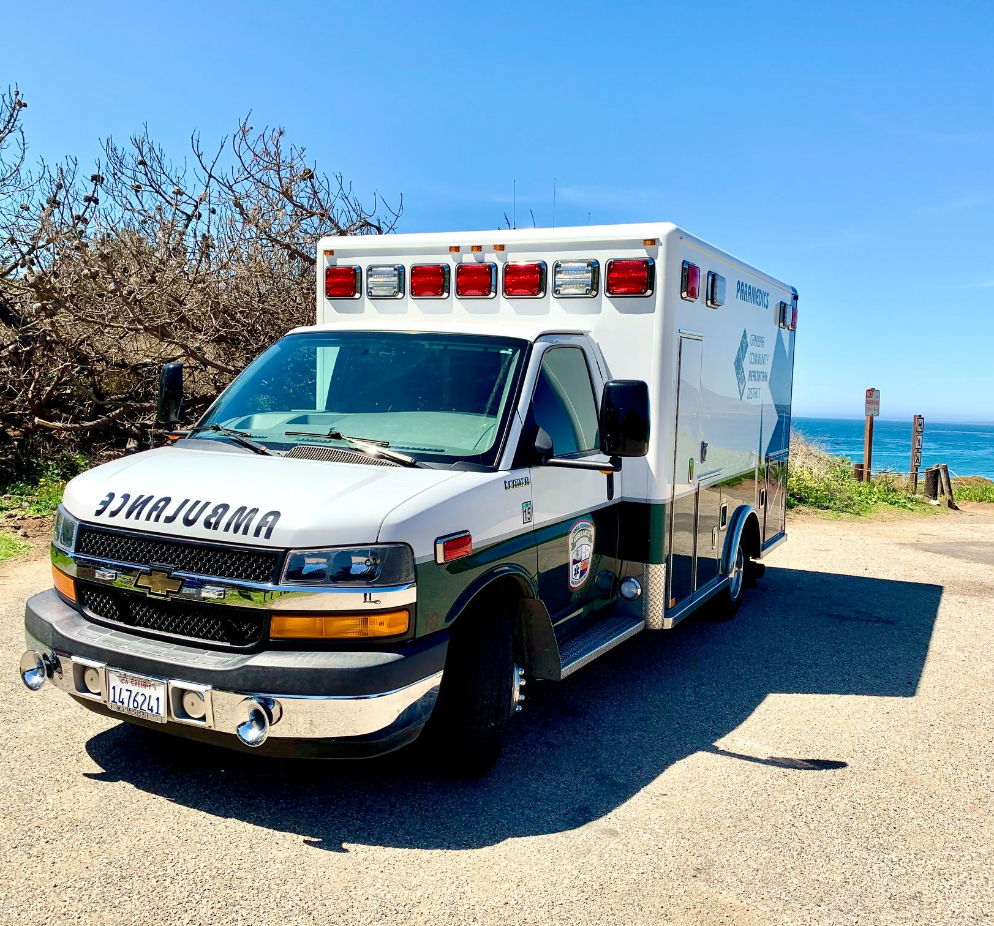
Conclusions and next steps
Update detailed plan (see excel document)
Implement communications plan for employees and the public
Monitor progress against the plan at least quarterly
The strategic planning process is continuous

