Slide 1






CAMBRIA COMMUNITY HEALTHCARE DISTRICT
2023 Community Survey Results

Slide 2

Mission Statement: To improve the health of District residents and visitors by providing emergency services, advocating for access to care, and promoting wellness.
CAMBRIA COMMUNITY HEALTHCARE DISTRICT
Provide Emergency Medical Service (EMS)
Response and Ambulance Transport
Advocating for Access to Care
Promote Wellness

Slide 3
220 Community Members Responded
65% Female
35% Male
Average Age: 70 years
Response Locations: See Back Up Slide
2023 Community Survey
Over the course of two months May – June 2023,
670 hard copy surveys and digital surveys were distributed throughout Cambria & San Simeon
Surveys were provided in both English and Spanish

Slide 4

Survey Process
Step 1
Distribution: Service Clubs, Farmers Markets, Local Churches, Community Events, Website, Digital Email and In Person Distribution.
Step 2
Collection: Online Response, Hard Copy Collection.
Step 3
Survey Results: Tabulate Responses, Present to CCHD Board of Directors and Community.
Step 4
Follow Up: Committee Members and Board of Directors to Provide Recommended Action & Programs.

Slide 5
Question # 1
Which top 2 health services are the most urgently needed in Cambria right now?
Question # 2
Which existing health services would you like to see improved, longer term, from now through 2026?
Top three survey responses

Slide 6
Question # 3
Which healthcare educational programs and/or healthcare speakers would you like to see available to the community in 2023-2024?
Priorities: Top Seven | Respondents | English | Spanish | %
Mental Health: Resources, Doctors, Services in Central Coast | 91 | 68 | 23 | 43.12%
Nutrition for a Healthy Lifestyle | 79 | 55 | 24 | 37.44%
Heart Health | 79 | 56 | 23 | 37.44%
Stroke Prevention | 76 | 60 | 16 | 36.00%
AED & CPR Training | 75 | 67 | 8 | 35.54%
Walking Tips, Tools & Fall Prevention | 66 | 54 | 12 | 31.27%
Stress Management Tools: Relaxation Exercises, Meditation | 65 | 45 | 19 | 30.80%
Priorities Continued: | Respondents | English | Spanish | %
Advances in Hearing: Aids and Services | 61 | 46 | 15 | 28.9%
Smiling is My Favorite: Dental Hygiene | 44 | 12 | 32 | 20.85%
Beauty is in the Eye of the Beholder: Vision & Eye Care | 44 | 27 | 17 | 20.85%

Slide 7
Question # 4
What other healthcare programs would you like available in Cambria?
Note: Write in Question

Slide 8
Suggested Action Steps:
Collect content expert information and schedule presenters for Community workshops on top 5 requested healthcare topic areas. In Progress
Add Mental Health Advisor to Outreach Committee to provide guidance on mental health topic areas. Done
Organize CCHD Resource Guide into a comprehensive healthcare tool with health tips and community health services directory. Direct mailer to Community. In Progress
Provide Dental Healthcare workshop to San Simeon community with Spanish translator.
Provide ongoing healthcare articles to publish in Cambria.ca regarding healthcare topics.

Slide 9
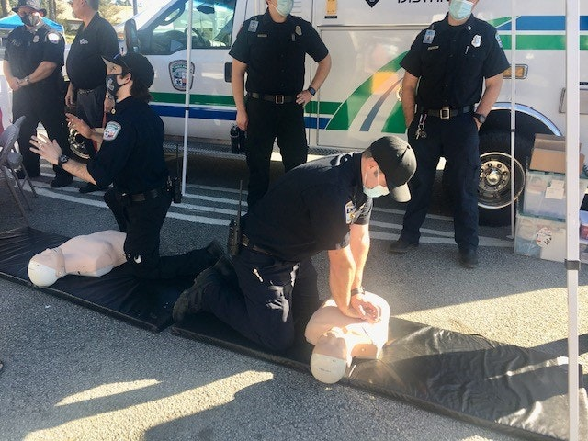
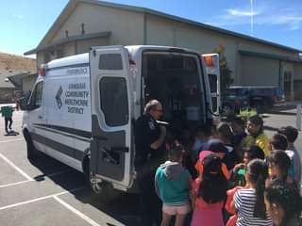
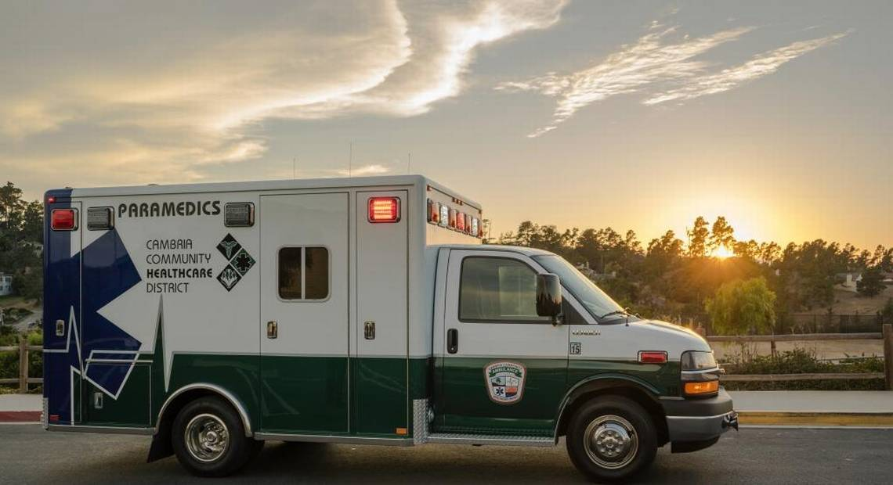
Cambria Community Healthcare District
EMS “Where Emergency Care Begins”

Slide 10
Back up data

Slide 11
English Surveys Returned
Area you Reside In:
Spanish Surveys Returned
Area you Reside In:
Location | # Respondents
Lodge Hill | 73
Park Hill | 18
Happy Hill | 14
Pine Knolls | 9
Marine Terrace | 31
Leimert Estates | 3
West Village | 4
East Village | 2
Seaclift Estates | 3
Top of the World | 5
San Simeon | 4
Other | 7
Location | # Respondents
Lodge Hill | 6
Park Hill | 0
Happy Hill | 0
Pine Knolls | 0
Marine Terrace | 0
Leimert Estates | 2
West Village | 0
East Village | 1
Seaclift Estates | 0
Top of the World | 0
San Simeon | 14
Other | 3

Slide 12
Top Priorities | # Respondents
Primary Care Doctors | 63
Urgent Care/Emergency Care | 47
Lab Services | 28
X-Ray Services | 25
Ambulance Services | 16
Mental Health Services | 16
Geriatric Care/Home Health | 11
Chronic Illness | 11
Dental Health | 15
Vision | 8
Bilingual Medical Services | 6
Free Health Care/Health Clinic | 6
Physical Therapy/Chiropractic | 1
Stroke Prevention/Hearth Health | 2
Chronic Illness Information | 9
Nutrition | 1
Question # 1
What are your top two health services most urgently needed in Cambria?

Slide 13
Top Priorities | # Respondents
Doctors – Primary & Specialty | 27
Lab Services | 28
Better/Improved Ambulance Building | 17
Urgent Care | 10
Homebound Services/Geriatric Programs | 8
Alternative & Complimentary Health Services | 7
Dental | 6
CHC | 7
Chronic Illness Information | 8
Medical Services in Spanish | 6
X-Ray | 3
Mental Health Services | 2
Information on action to take if a child starts to drown | 1
Decrease wait time in Doctors office | 1
Question # 2
Which existing health services would you like to see improved through 2026?

Slide 14
Question # 4
What other healthcare programs would you like available in Cambria?
Note: Write in Question
Top Priorities | # Respondents
Living with Chronic Illness | 17
Hearing & Vision Services | 4
X-Ray & Imaging Services | 4
Increase access to Doctors, more Doctors | 3
Lab Services | 2
Urgent Care | 2
Dental Care | 2
Health Care Information Online | 1
Women’s Health | 1
Wellness Programs for Seniors | 1
Priorities Continued | # Respondents
First Aid Program | 1
Promoting Oral Language for Toddlers | 1
Addition of a Helipad for Emergencies | 1
Swimming Pool | 1
More Park Space for Children’s Programs | 1
Hiking Club | 1
Support Group for Family Caregivers | 1
Medicare Education | 1
Allergy Information | 2
Spinal Injury | 1

Slide 15
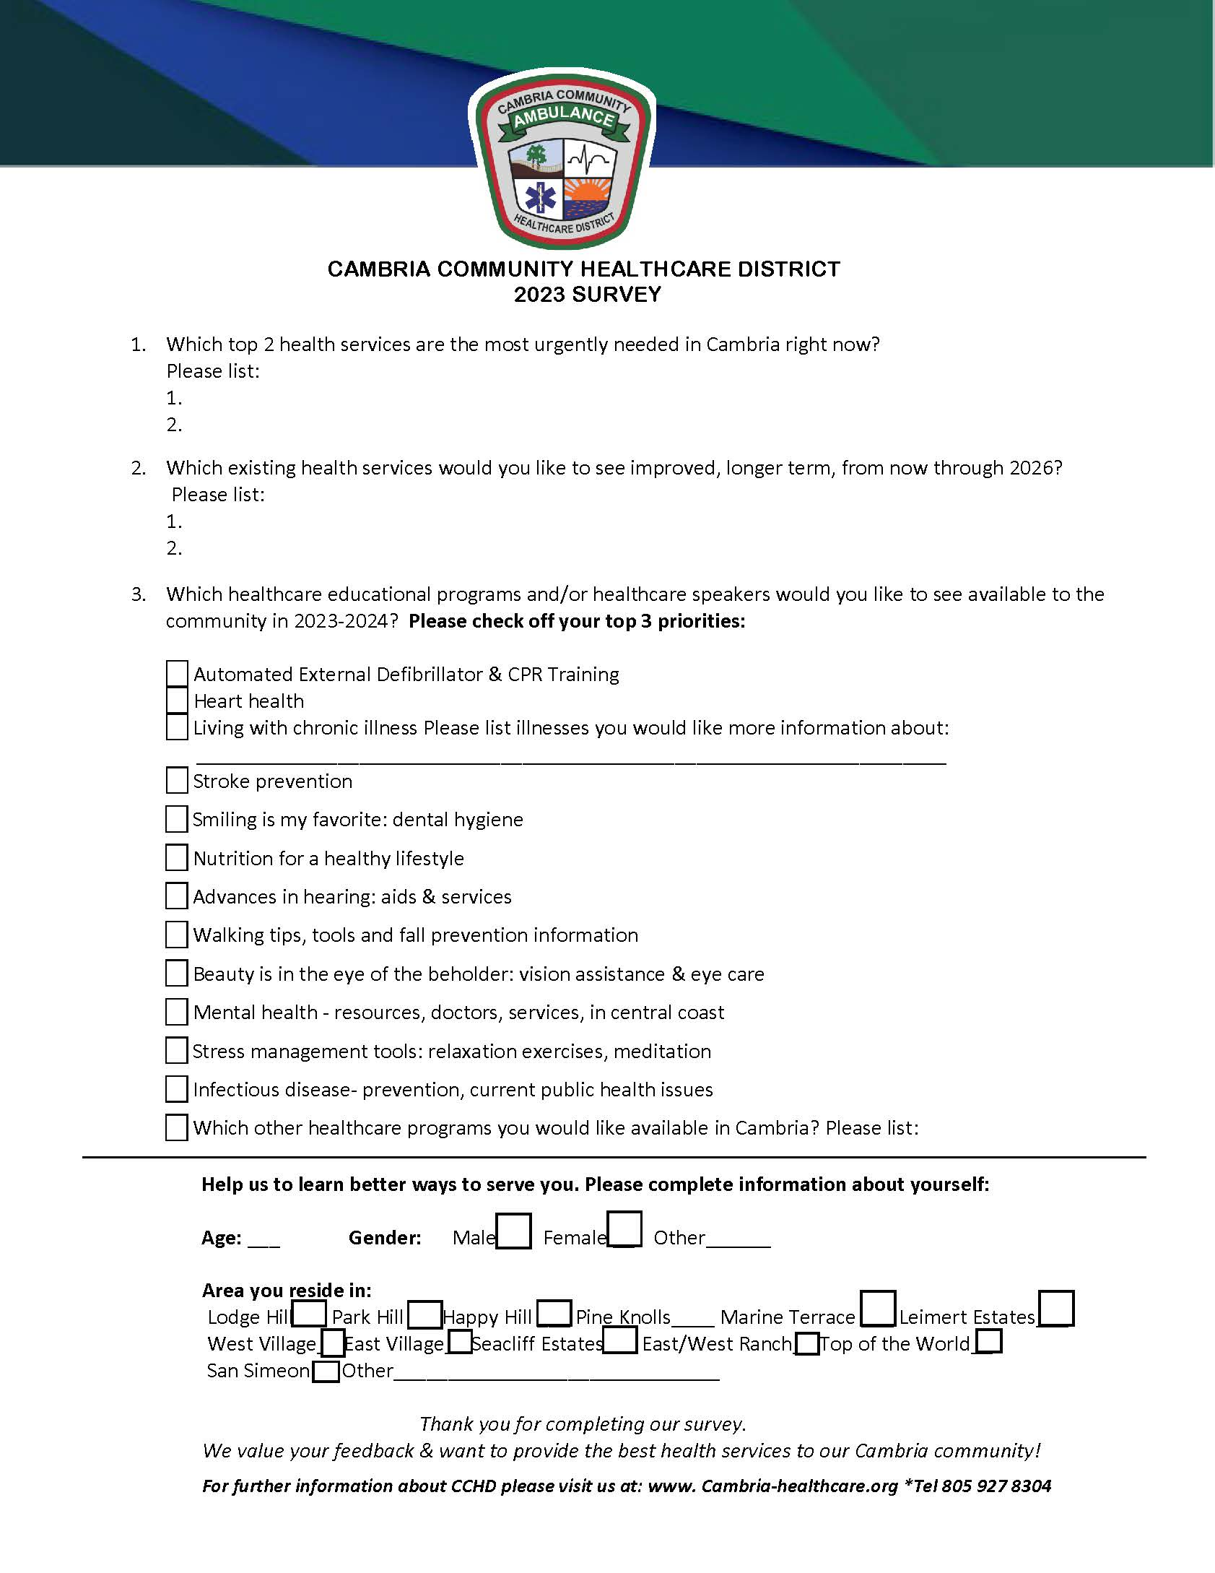
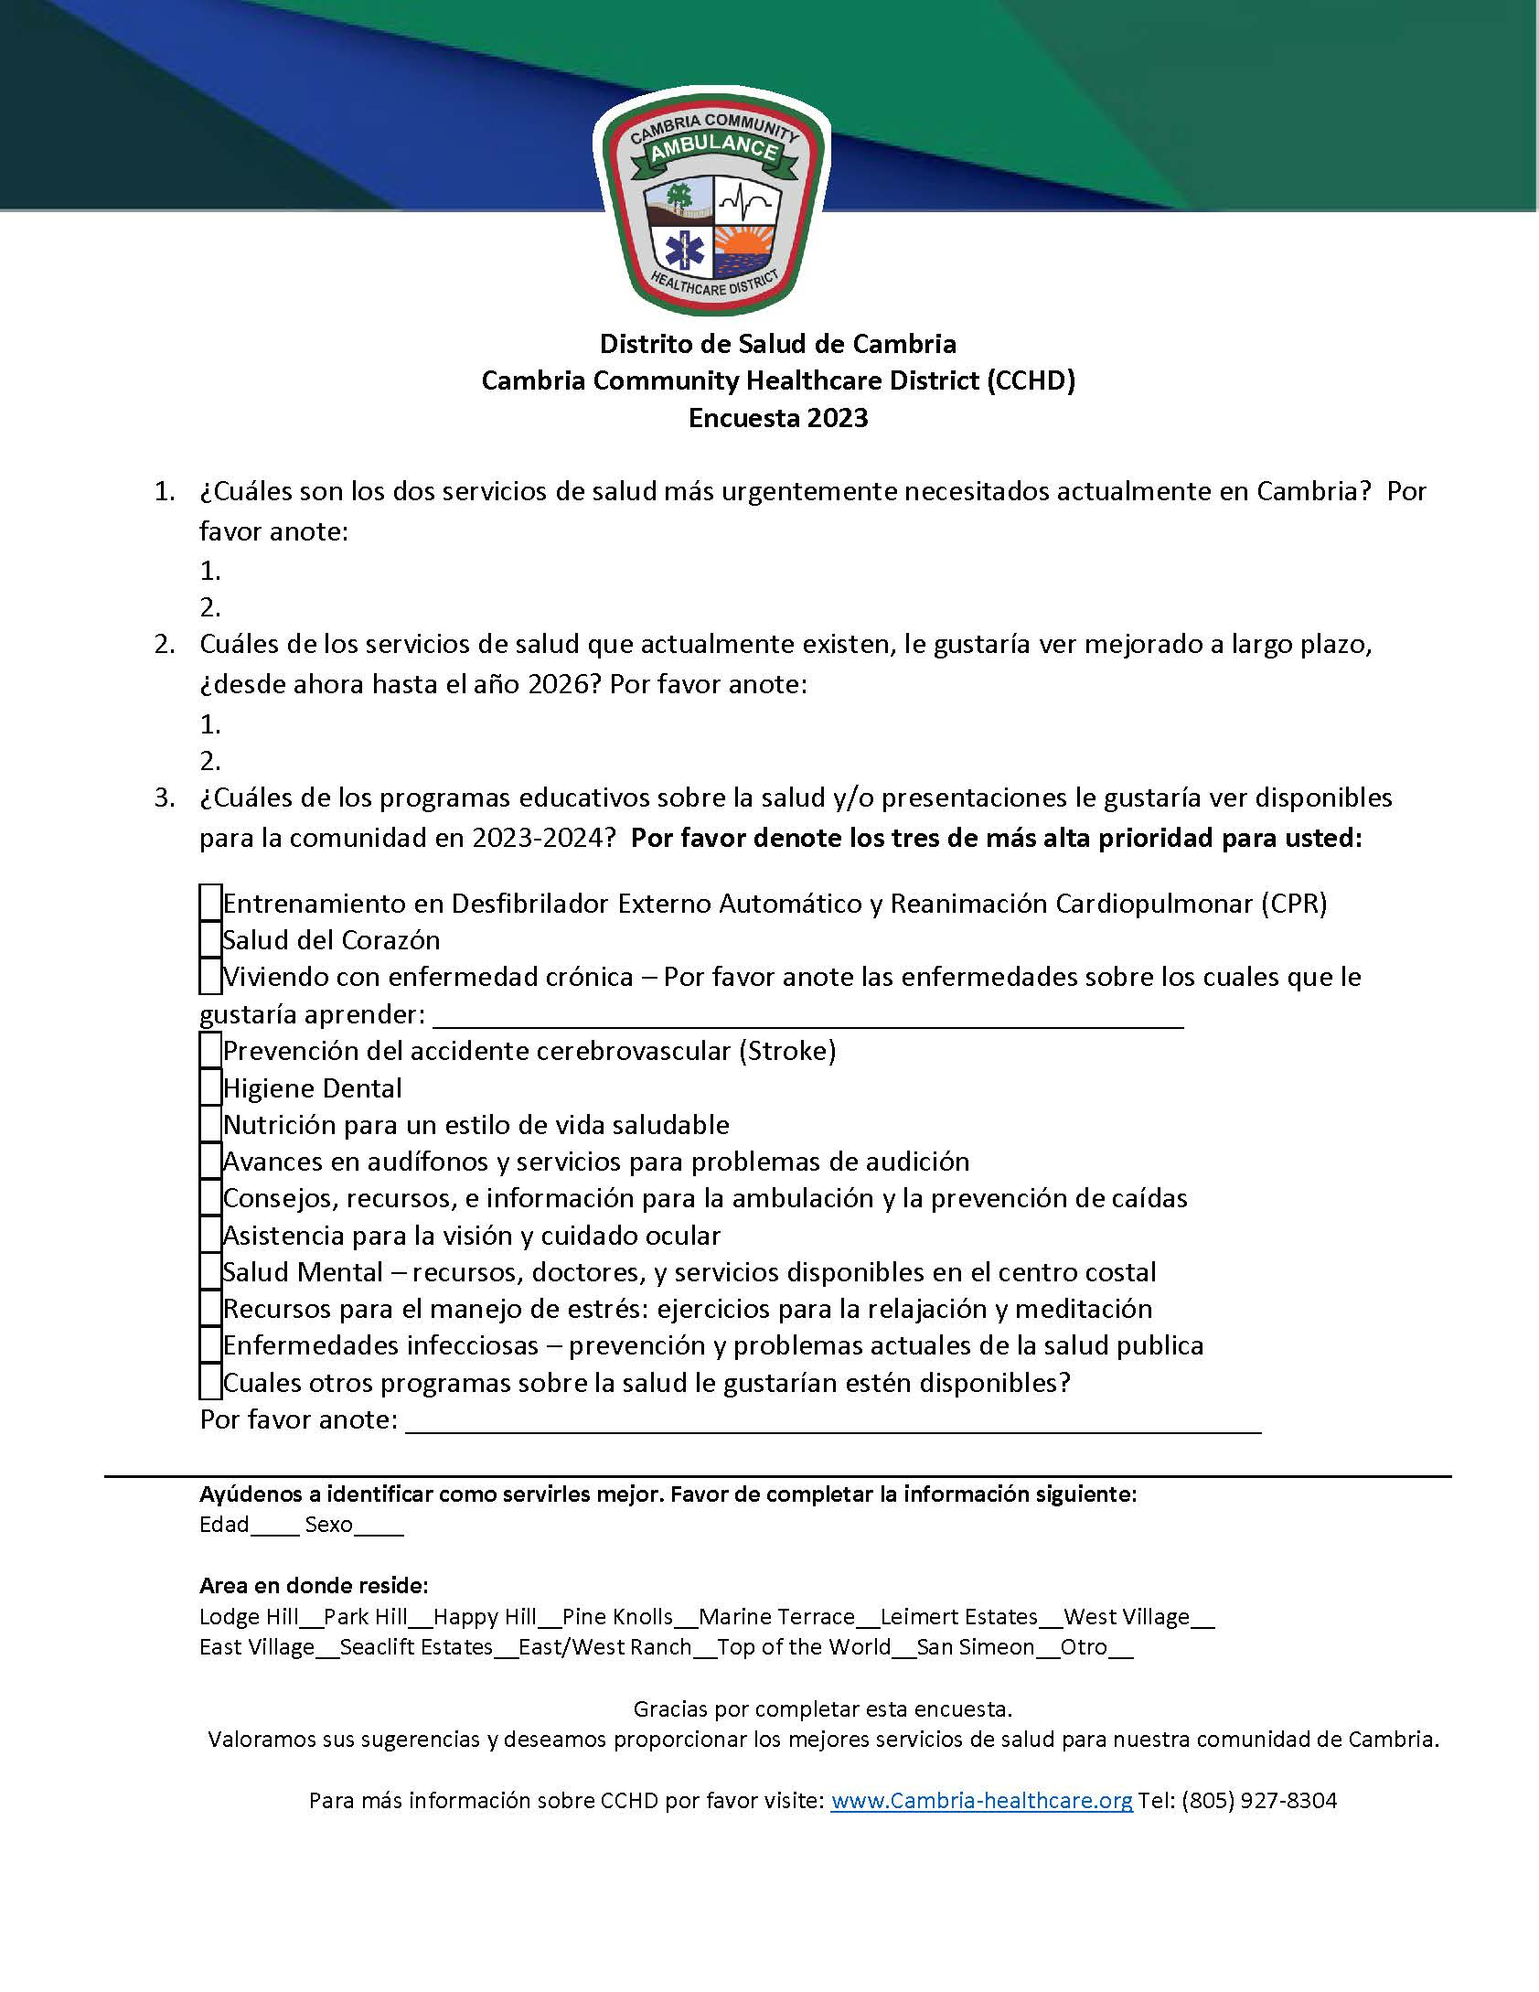
2023 Survey was provided in both English and Spanish
Available at www.cambria-healthcare.org

